Slide 1
Access to Medicine Providers in Relation to Demography
Catherine Chen
3-14-2020

Slide 2
Research objectives
This project examines the distribution of pharmacies in Toronto in relation to the spatial distribution of seniors who are over 65 years old
Relying on the data from Four Square, I retrieve location of pharmacies located within around 140 neighborhoods in Toronto, evaluate the access of each neighborhood, and examine the relationship with senior population.

Slide 3
Data and methodology
First, I collected neighborhood profile data from https://www.toronto.ca/city-government/data-research-maps/neighbourhoods-communities/neighbourhood-profiles/ and www.toronto.ca/wellbeing
Main demographic data I download are total population in each neighborhood and population over 65 years old. Based on these data, I calculated the percentage of seniors in each neighborhood.

Slide 4
Four Square
Second, I made request to Four Square and get the number of pharmacies within 1000 meters centered around each neighborhood.
I originally planned to collected data on clinics and hospitals. However, such calls produced few records from Four Square. Therefore, I had to change plan and concentrate on pharmacies instead. I have a sense that Four Square has a better database for shopping and dining instead of other facilities.

Slide 5
Logit model
Third, with all the data I need, I summarized and compared the neighborhoods that have access to pharmacy within 1000km. I developed a logistic model to examine whether the access to pharmaceutical service is related to the distribution of senior population.

Slide 6
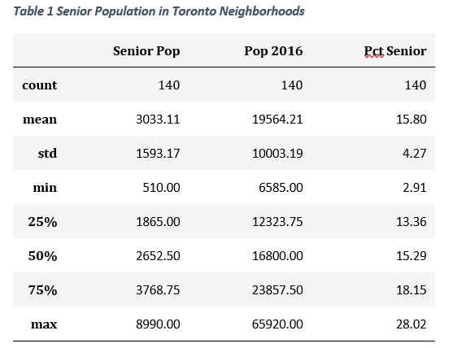
Results

Slide 7
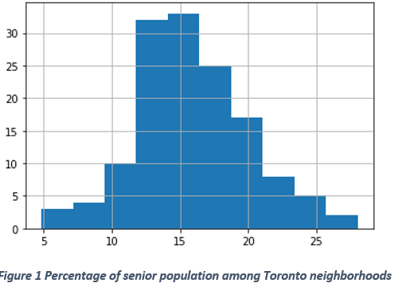


Slide 8
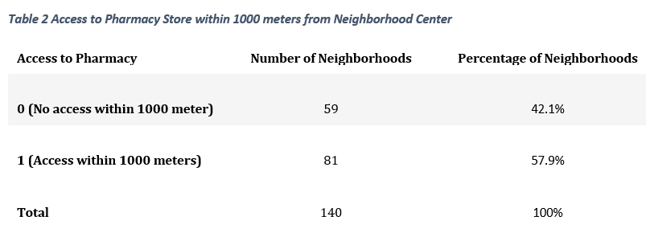

Slide 9
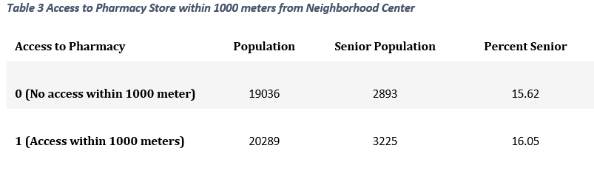

Slide 10
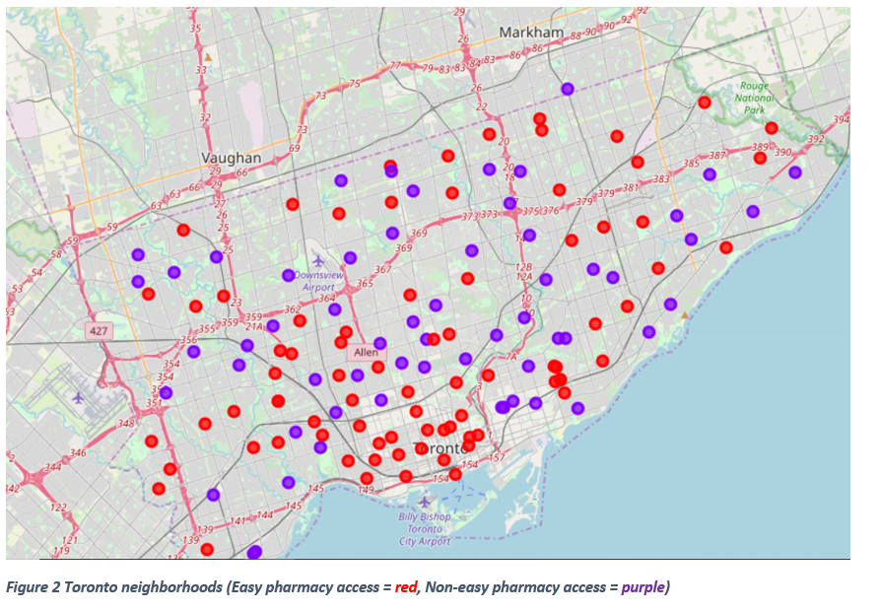

Slide 11
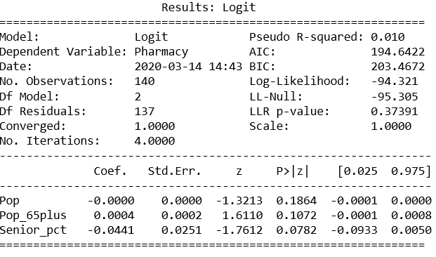

Slide 12
Conclusion
Depending on Four Square API, I found that 57.9% of the neighborhoods have access to at least one pharmacy service within 1000 meters of the neighborhood center.
The easy access zone covers 3,225 seniors while the non-easy access zone covers 2893. the average senior percentage is 15.6% for the former and 16.05 for the latter.

Slide 13
Senior residents in downtown Toronto have easier access to pharmacy services compared to other parts of the city.
Logit model shows that there is little association between the spatial distribution of pharmacy store and senior population.

Slide 14
Discussion
These results suggest that there is still space for the Toronto city government to provide more pharmacy service to its residents, and to give special consideration to its senior citizens.
But still, these results are subjected to the quality of Four Square data.

Slide 15
End

